Slide 1
What is Graph?
V
Vertix (Node)
Edge (Arcs)

Slide 2
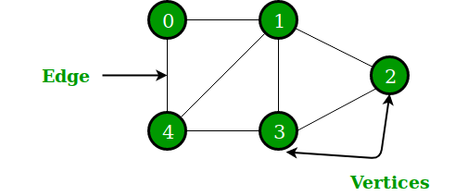
Graph
The set of vertices V = {0,1,2,3,4}
The set of edges E = {01, 12, 23, 34, 04, 14, 13}.

Slide 3
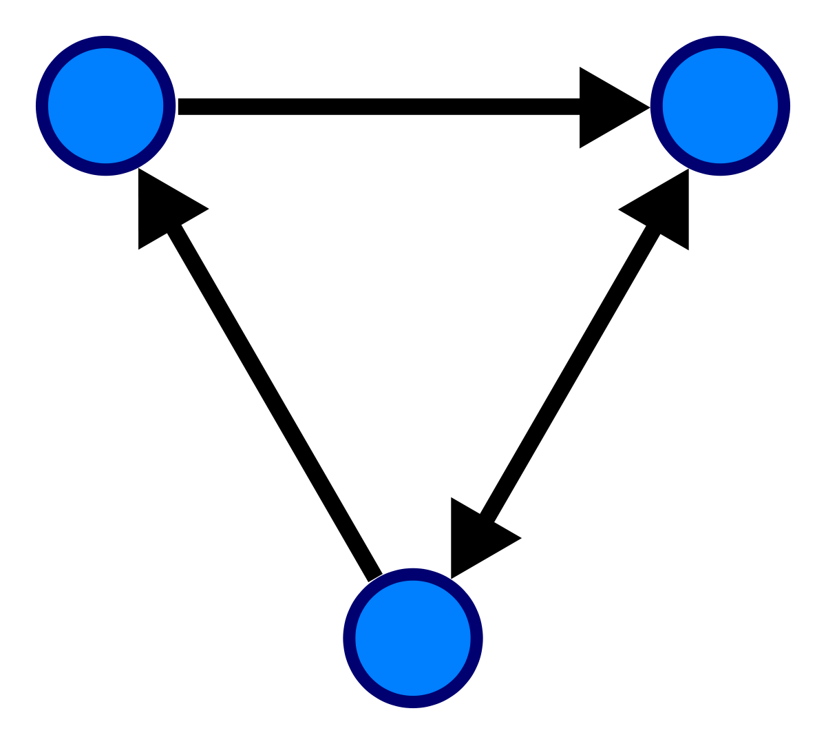
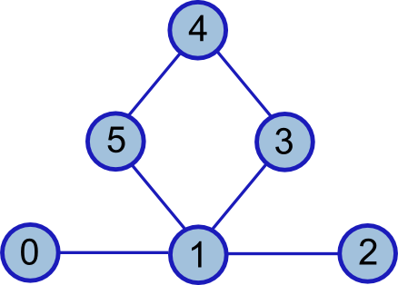
Graph
Directed (Di-Graph)
Un-Directed Graph
Edges have a specific direction
Edges haven’t a specific direction
One-way Relationship
Two-way relationship

Slide 4
Graph
Graph with directed Edges
Graph with undirected Edges
A
B
A
B
C
D
C
D

Slide 5
Different kind of Graphs
Weighted Graph
Complete Graph
A
7
B
A
B
8
4
E
2
3
C
D
5
C
D
6

Slide 6
Graph Representation
Graph
Adjacency Matrix
 | A | B | C | D
A | 0 | 1 | 1 | 0
B | 0 | 0 | 0 | 1
C | 0 | 0 | 0 | 1
D | 1 | 0 | 0 | 0
A
B
C
D

Slide 7
Graph Representation
Graph
Adjacency List
A
B
A
B
C /
B
D /
C
D /
C
D
D
A /

Slide 8
Operation on Graphs
Searching in a Graph
Inserting in a Graph
Deletion from a Graph
Traversing a Graph - BFS, DFS
Sorting - Topological Sort

Slide 9
Keyword/terms in Graphs
DAG?

Slide 10
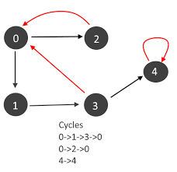
Keywords/terms in Graphs
Directed Cyclic Graph
7
5
3
11
8
2
9
10

Slide 11
Keywords/terms in Graphs
Find Cycle?
1
0
5
C
A
B
E
2
7
D
F

Slide 12
Keywords/terms in Graphs
Find PATH?
2 -> 7
A -> F
1
0
5
C
A
B
E
2
7
D
F

Slide 13
Keywords/terms in Graphs
Find Adjacent? (u,v)?
2,0,7 (u<->v)
A,D,F (u->v)
1
0
5
C
A
B
E
2
7
D
F

Slide 14
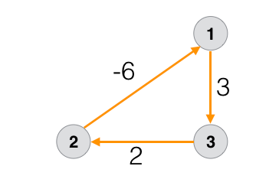
Keywords/terms in Graphs
Negative edge cycle
Total Weight: -6 + 3 + 2 = -1

Slide 15
Keywords/terms in Graphs
Degree? Number of edges
A
A = 3
B = 3
C = 1
D = 1
E = 2
C
B
E
D

Slide 16
Keywords/terms in Graphs
Directed Graph degree two types
Vertex | Indegree | Outdegree
A | 0 | 1
B | 2 | 1
C | 1 | 1
D | 1 | 1
E | 1 | 2
F | 1 | 0
C
A
B
E
D
F

Slide 17
Keywords/terms in Graphs
Source: A vertex which has no incoming edges but has outgoing edges.
Sink: A vertex which has no outgoing edges but incoming edges
Pendant Vertex: If a vertex has its indegree equals to 1 and outdegree 0.
C
G
Isolated vertex
A
B
E
Source
Sink
D
F
Pendant vertex

Slide 18
Keywords/terms in Graphs
Successor and Predecessor
C
B is successor of A (child of A)
A is predecessor of B (parent of B)
A
B
E
D
F

Slide 19
Any Suggestion?
?

